Slide 1
Lec 4: Elementary signals + Differentiation Operation
Dr. Arsla Khan

Slide 2
Basic / Elementary Signals
Standard signals are used for the analysis of systems. These signals are;
Unit step function
Unit impulse or Delta function
Unit ramp function
Complex exponential function
Sinusoidal function

Slide 3
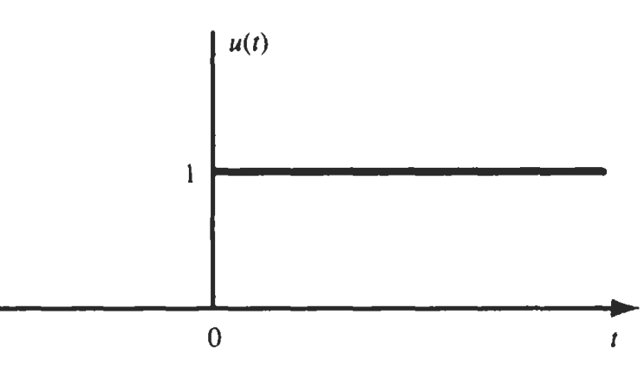
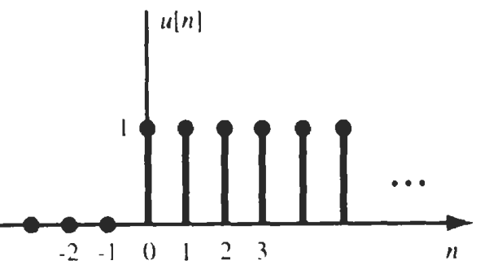
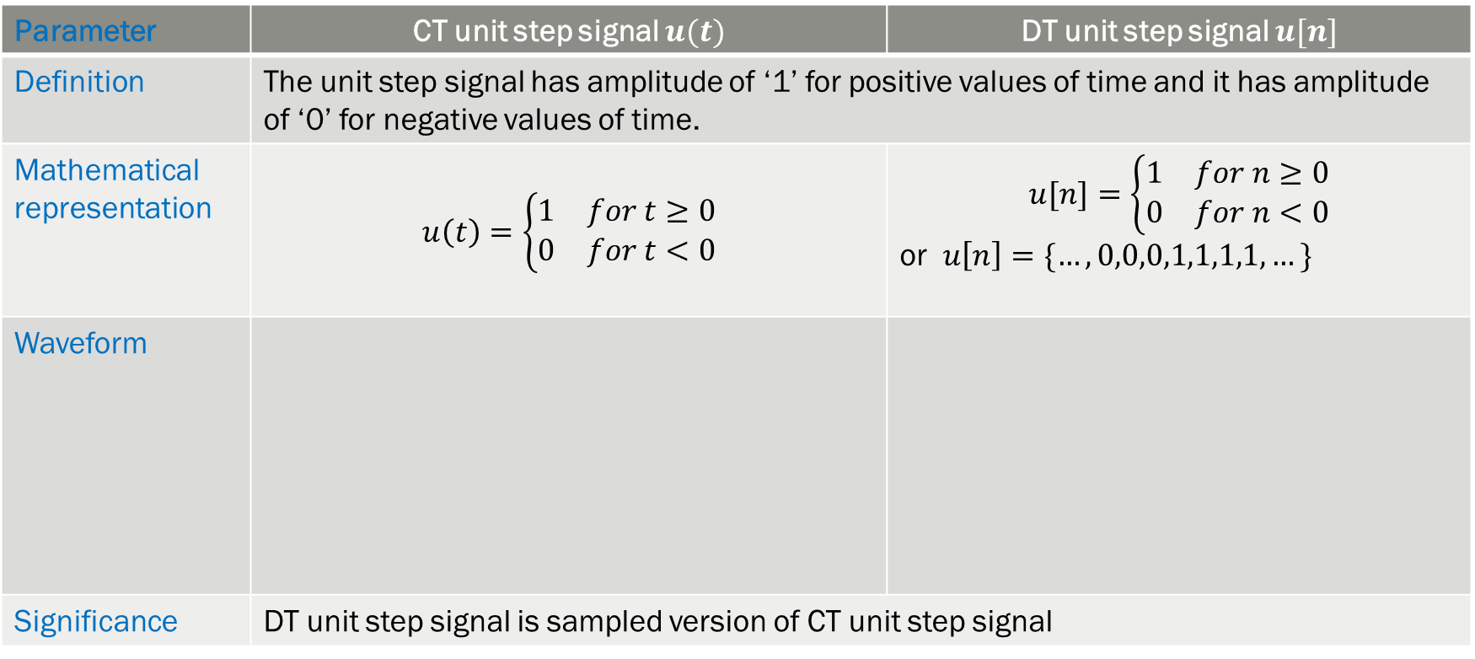
1. Unit Step function ($u\left(t\right) or u[n]$)
Parameter | CT unit step signal $u(t)$ | DT unit step signal $u[n]$
Definition | The unit step signal has amplitude of ‘1’ for positive values of time and it has amplitude of ‘0’ for negative values of time.
Mathematical representation | $$u\left(t\right)=\left\{\begin{aligned}\begin{matrix}1 & for t≥0\end{matrix} \\ \begin{matrix}0 & for t<0\end{matrix}\end{aligned}\right.$$ | $$u[n]=\left\{\begin{aligned}\begin{matrix}1 & for n≥0\end{matrix} \\ \begin{matrix}0 & for n<0\end{matrix}\end{aligned}\right.$$ or $u\left[n\right]=\{…,0,0,0,1,1,1,1,…\}$
Waveform
Significance | DT unit step signal is sampled version of CT unit step signal

Slide 4
Plot x(t)=u(t)+u(-t) ???
4

Slide 5
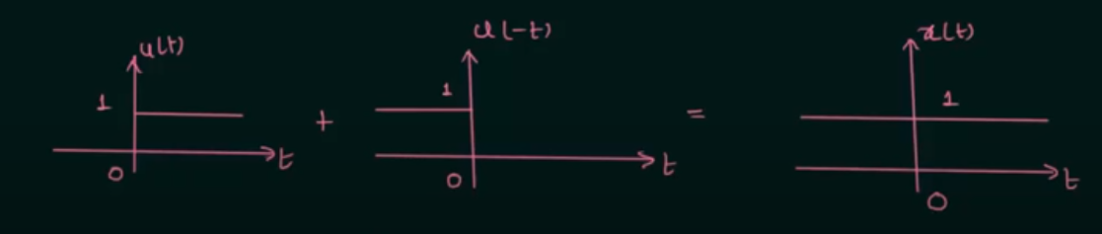

$$x(t)$$

Slide 6
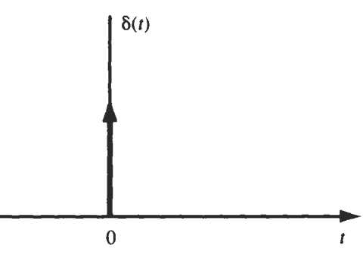
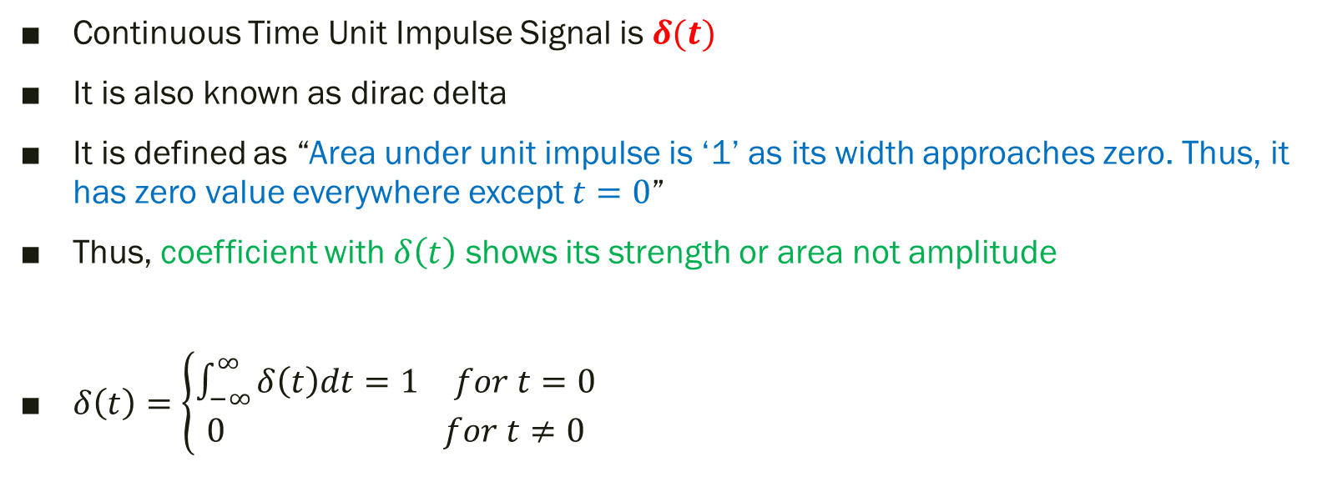
2. Unit Impulse Signal
1
Continuous Time Unit Impulse Signal is $δ(t)$
It is also known as dirac delta
It is defined as “Area under unit impulse is ‘1’ as its width approaches zero. Thus, it has zero value everywhere except $t=0$”
Thus, coefficient with $δ\left(t\right)$ shows its strength or area not amplitude
$δ\left(t\right)=\left\{\begin{aligned}\begin{matrix}\int_{−∞}^{∞}{δ\left(t\right)dt=1} & for t=0\end{matrix} \\ \begin{matrix}0 & for t≠0\end{matrix}\end{aligned}\right.$

Slide 7
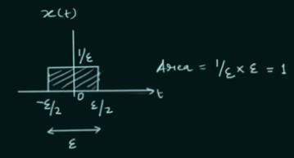
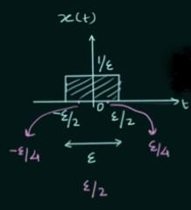
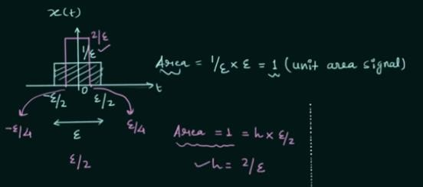

Slide 8




A) Time Shifting
i) $δ\left(t−2\right)$
ii) $δ\left(t+3\right)$
2
-3
B) Amplitude Scaling
C) Time Scaling
2/5
iii) $\frac{2}{5}δ\left(t\right)$
$δ\left(at\right)=\frac{1}{\left|a\right|}δ\left(t\right)$
0

Slide 9
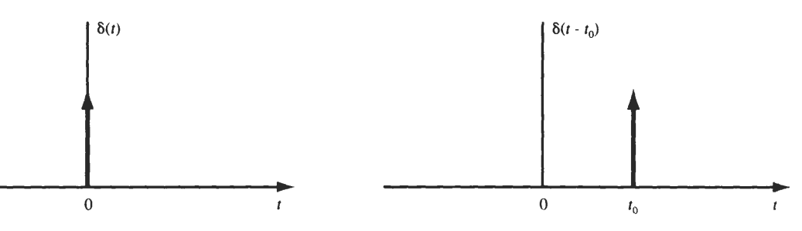
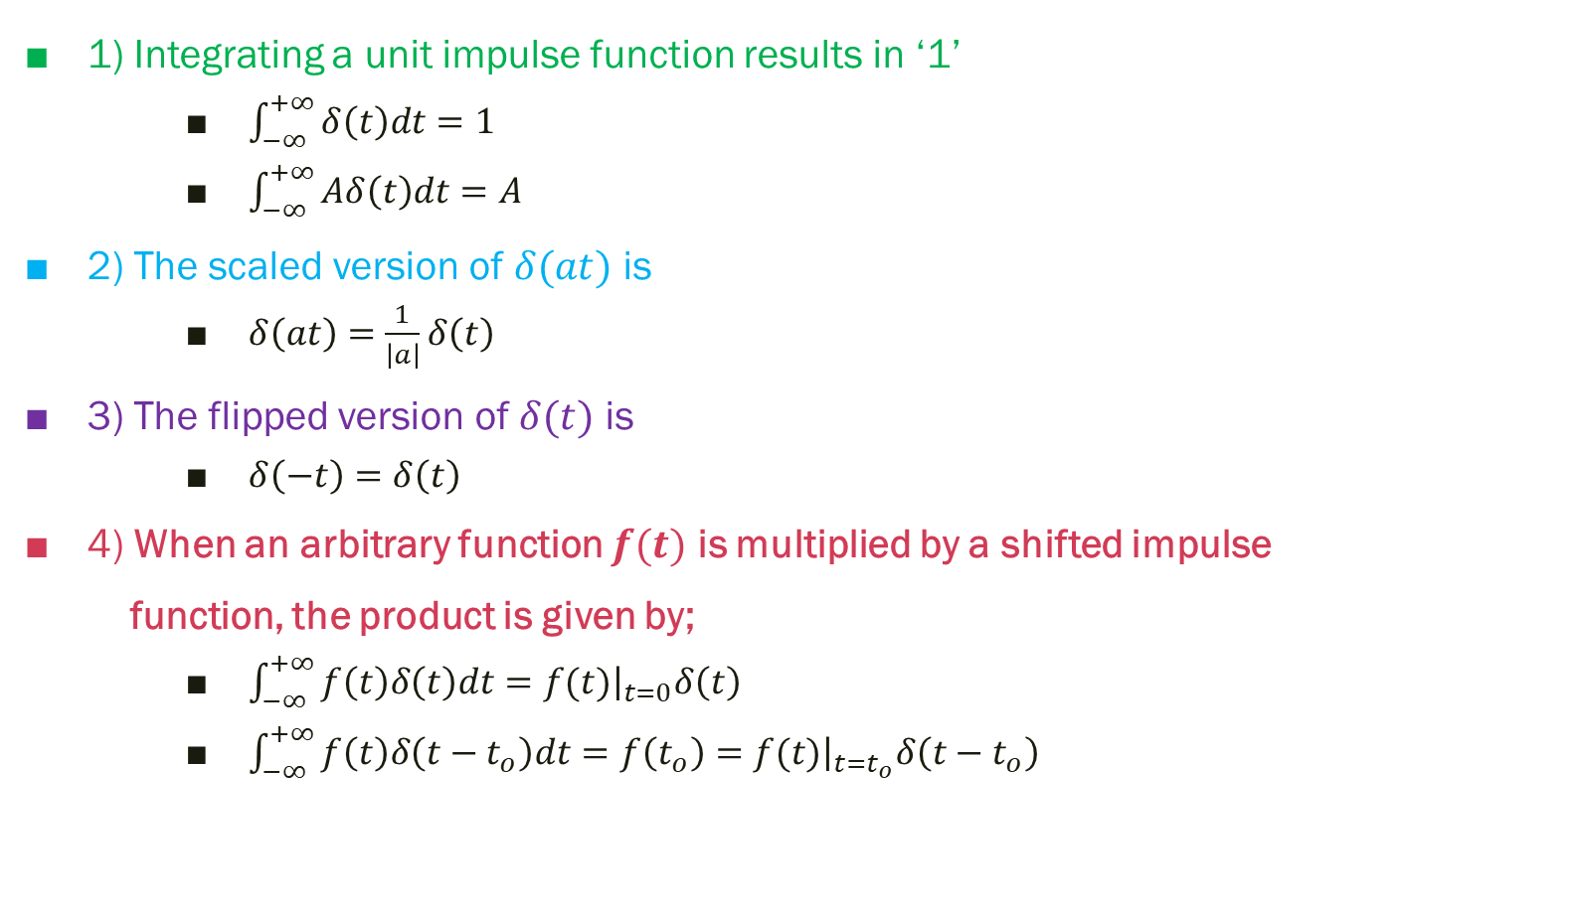
Properties of CT Unit Impulse or Delta function $δ(t)$
1) Integrating a unit impulse function results in ‘1’
$\int_{−∞}^{+∞}{δ\left(t\right)dt}=1$
$\int_{−∞}^{+∞}{Aδ\left(t\right)dt}=A$
2) The scaled version of $δ(at)$ is
$δ\left(at\right)=\frac{1}{\left|a\right|}δ\left(t\right)$
3) The flipped version of $δ(t)$ is
$δ\left(−t\right)=δ\left(t\right)$
4) When an arbitrary function $f(t)$ is multiplied by a shifted impulse
function, the product is given by;
$\int_{−∞}^{+∞}{f\left(t\right)δ\left(t\right)dt}={\left.f(t)\right|}_{t=0}δ\left(t\right)$
$\int_{−∞}^{+∞}{f\left(t\right)δ\left(t−t_{o}\right)dt}=f\left(t_{o}\right)={\left.f(t)\right|}_{t=t_{o}}δ\left(t−t_{o}\right)$

Slide 10

Exp 4.1: Evaluate i) $\int_{−∞}^{+∞}{e^{−t}δ\left(2t−2\right)dt}$ ii) $\int_{−5}^{−2}{e^{−t}δ\left(2t−2\right)dt}$
(i) $\int_{−∞}^{+∞}{e^{−t}δ\left(2t−2\right)dt}$ ii) $\int_{−5}^{−2}{e^{−t}δ\left(2t−2\right)dt}$
$δ\left(2t−2\right)=δ\left[2\left(t−1\right)\right]=\frac{1}{2}δ\left(t−1\right)$ = 0
=$\int_{−∞}^{+∞}{e^{−t}\frac{1}{2}δ\left(t−1\right)dt}$
= $\frac{1}{2} \int_{−∞}^{+∞}{e^{−t}δ\left(t−1\right)dt}$
= $\frac{1}{2}$ ${\left.e^{−t}\right|}_{t=1}$
= $\frac{1}{2}$ $e^{−1}$
*Unit impulse should be present between the limits of integration

Slide 11
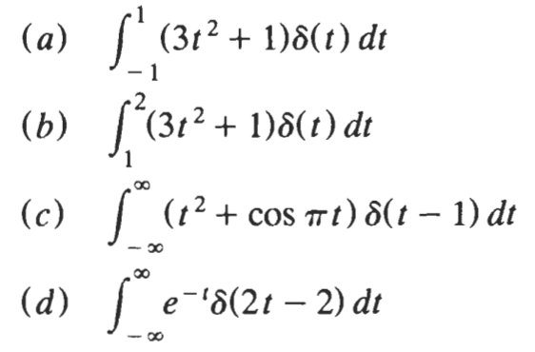
Exp 4.2: Evaluate the following integrals

Slide 12
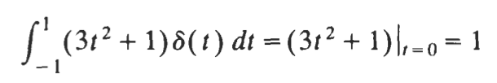
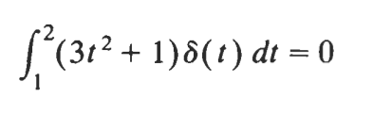
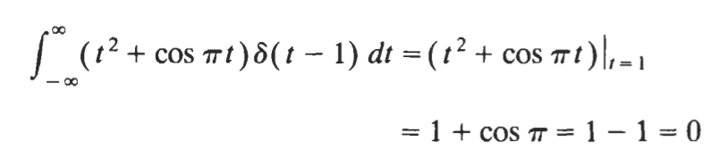
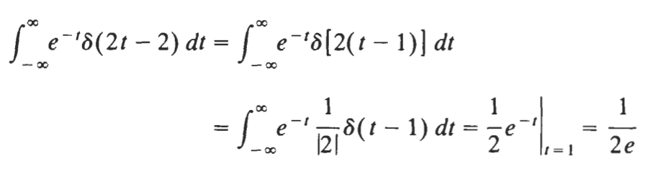
Solution:
(a)
(b)
(c)
(d)

Slide 13
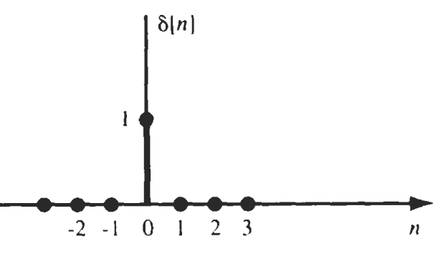
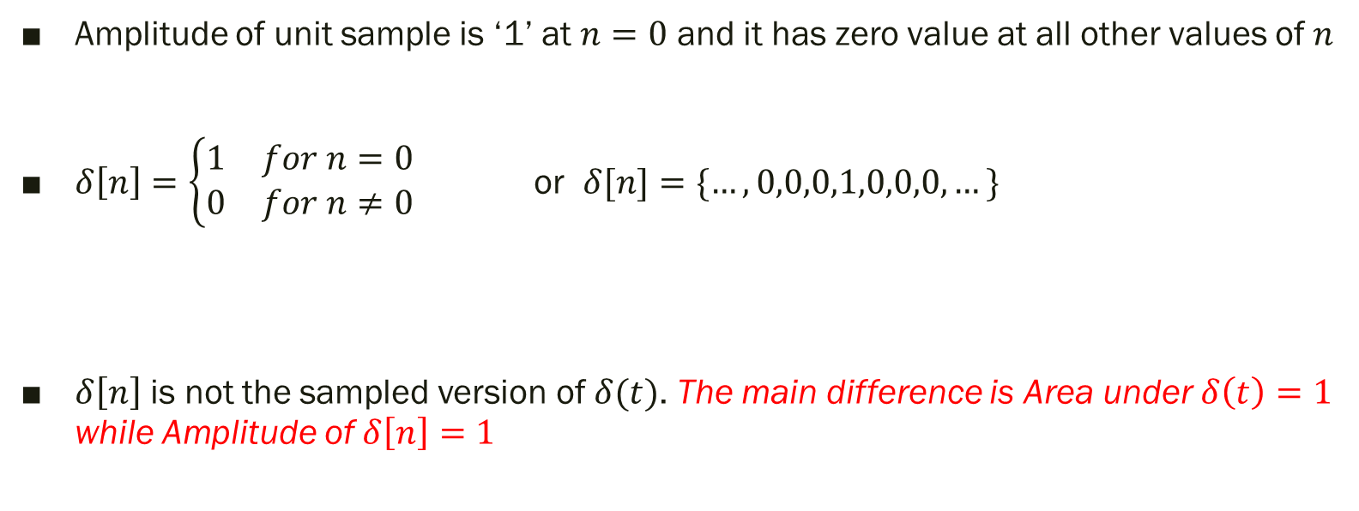
DT Unit Sample Signal/ Unit Impulse Sequence $δ[n]$
Amplitude of unit sample is ‘1’ at $n=0$ and it has zero value at all other values of $n$
$δ\left[n\right]=\left\{\begin{aligned}\begin{matrix}1 & for n=0\end{matrix} \\ \begin{matrix}0 & for n≠0\end{matrix}\end{aligned}\right.$ or $δ[n]=\{…,0,0,0,1,0,0,0,…\}$
$δ\left[n\right]$ is not the sampled version of $δ(t)$. The main difference is Area under $δ\left(t\right)=1$ while Amplitude of $δ\left[n\right]=1$

Slide 14
1 (Area/ Strength)
Amplitude

Slide 15
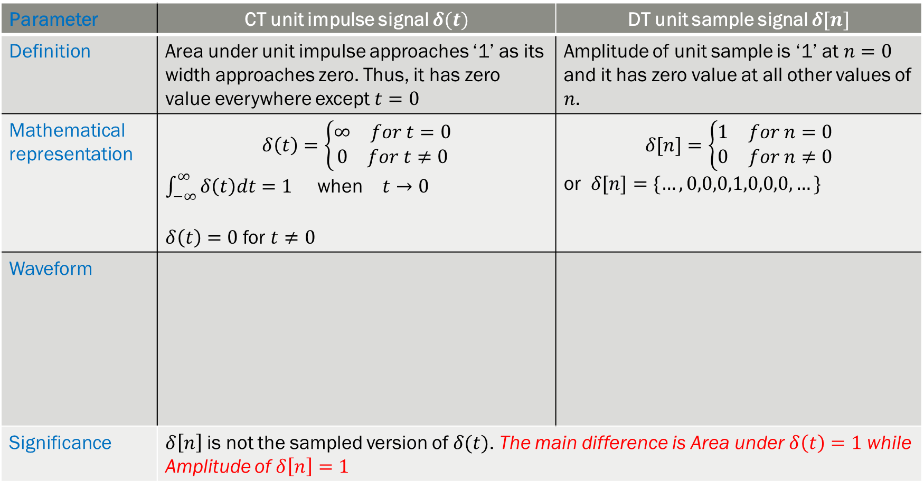
Parameter | CT unit impulse signal $δ(t)$ | DT unit sample signal $δ[n]$
Definition | Area under unit impulse approaches ‘1’ as its width approaches zero. Thus, it has zero value everywhere except $t=0$ | Amplitude of unit sample is ‘1’ at $n=0$ and it has zero value at all other values of $n$.
Mathematical representation | $$δ\left(t\right)=\left\{\begin{aligned}\begin{matrix}∞ & for t=0\end{matrix} \\ \begin{matrix}0 & for t≠0\end{matrix}\end{aligned}\right.$$ $\int_{−∞}^{∞}{δ\left(t\right)dt=1}$ when $t→0$ $δ\left(t\right)=0$ for $t≠0$ | $$δ[n]=\left\{\begin{aligned}\begin{matrix}1 & for n=0\end{matrix} \\ \begin{matrix}0 & for n≠0\end{matrix}\end{aligned}\right.$$ or $δ[n]=\{…,0,0,0,1,0,0,0,…\}$
Waveform
Significance | $δ\left[n\right]$ is not the sampled version of $δ(t)$. The main difference is Area under $δ\left(t\right)=1$ while Amplitude of $δ\left[n\right]=1$

Slide 16
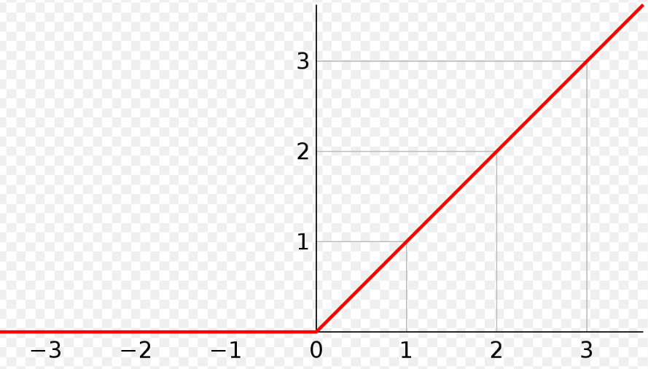
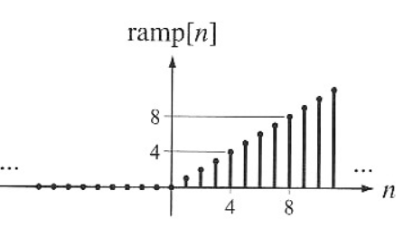
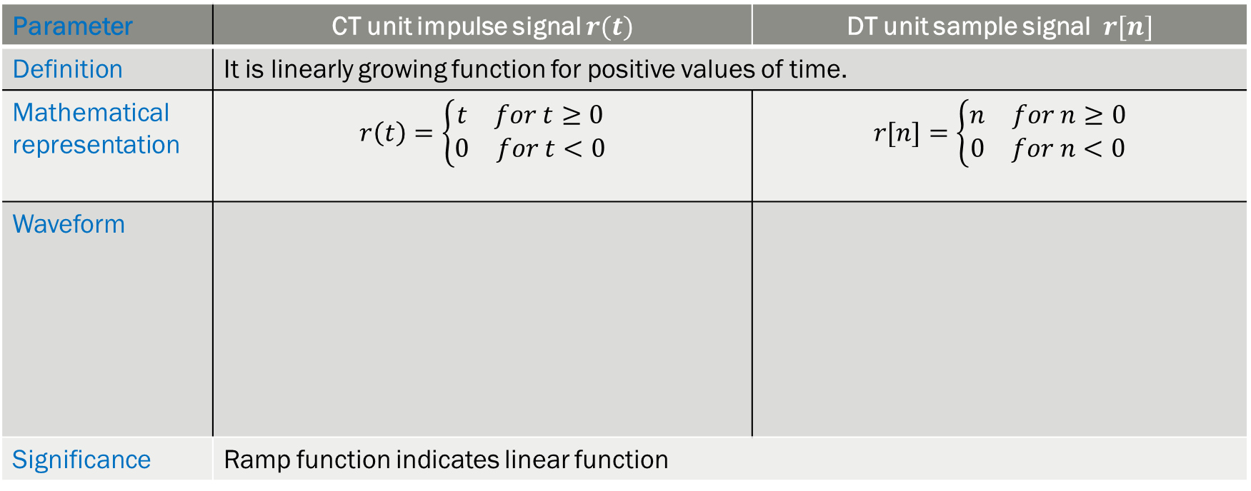
3. Unit Ramp function
Parameter | CT unit impulse signal $r(t)$ | DT unit sample signal $r[n]$
Definition | It is linearly growing function for positive values of time.
Mathematical representation | $$r\left(t\right)=\left\{\begin{aligned}\begin{matrix}t & for t≥0\end{matrix} \\ \begin{matrix}0 & for t<0\end{matrix}\end{aligned}\right.$$ | $$r[n]=\left\{\begin{aligned}\begin{matrix}n & for n≥0\end{matrix} \\ \begin{matrix}0 & for n<0\end{matrix}\end{aligned}\right.$$
Waveform
Significance | Ramp function indicates linear function
Prepared by: Dr. Arsla Khan, CUI Lahore Campus
16

Slide 17
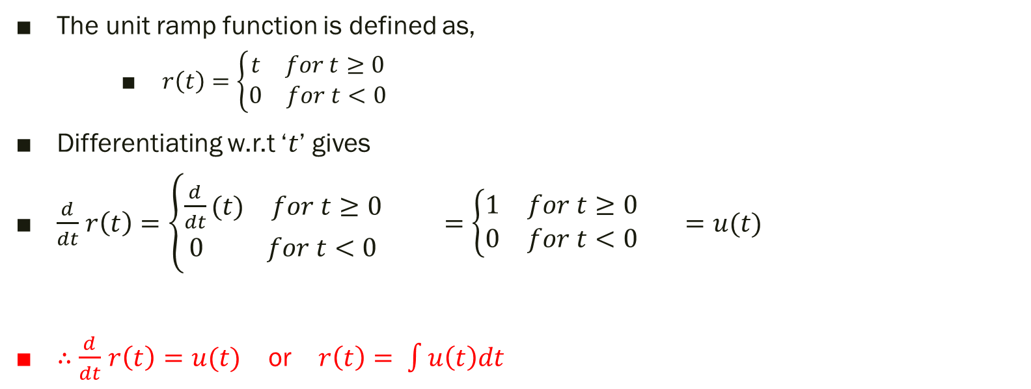
Relationship between the Signals
1. Relationship between Unit step and Unit ramp signal
The unit ramp function is defined as,
$r\left(t\right)=\left\{\begin{aligned}\begin{matrix}t & for t≥0\end{matrix} \\ \begin{matrix}0 & for t<0\end{matrix}\end{aligned}\right.$
Differentiating w.r.t ‘$t$’ gives
$\frac{d}{dt}$ $r\left(t\right)=\left\{\begin{aligned}\begin{matrix}\frac{d}{dt}(t) & for t≥0\end{matrix} \\ \begin{matrix}0 & for t<0\end{matrix}\end{aligned}\right.$ $=\left\{\begin{aligned}\begin{matrix}1 & for t≥0\end{matrix} \\ \begin{matrix}0 & for t<0\end{matrix}\end{aligned}\right.$ $=u(t)$
$∴$ $\frac{d}{dt}$ $r\left(t\right)=u(t)$ or $r\left(t\right)= \int{u\left(t\right)dt}$

Slide 18

2. Relationship between Unit step and Unit Impulse signal
$\frac{d}{dt}$ $u\left(t\right)=δ\left(t\right)$
or $u\left(t\right)= \int{δ\left(t\right)dt}$

Slide 19

P.P 4.1: How can we write $δ[n]$ in terms of $u\left[n\right].$ Also write $u[n]$ in terms of $δ[n]$

Slide 20
Exp 4.3: Draw waveform for the differentiated signal (****)
1
0
1
3
-1
2
1
2

Slide 21
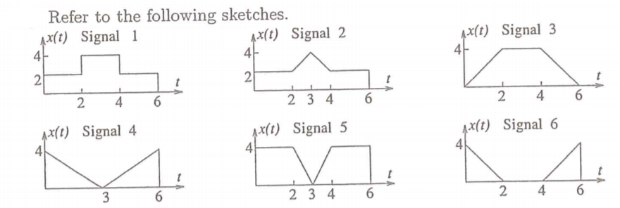
Exp 4.4: Draw waveform for the differentiated version of signals from 1 to 6

Slide 22

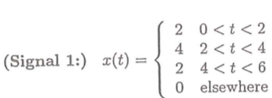
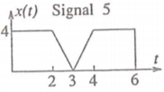
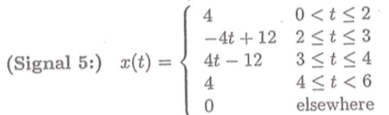
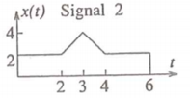
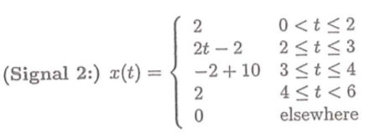
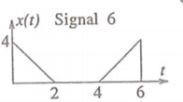
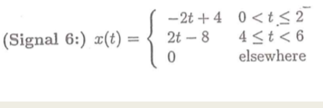
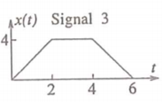
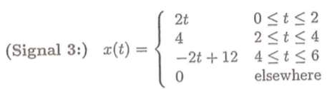
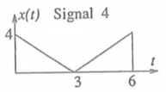
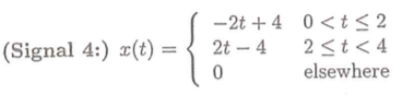

Slide 23
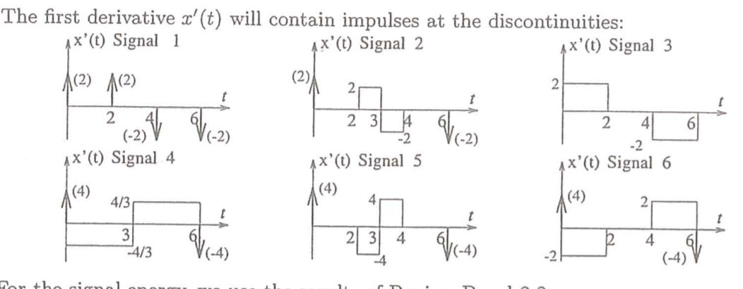

Slide 24
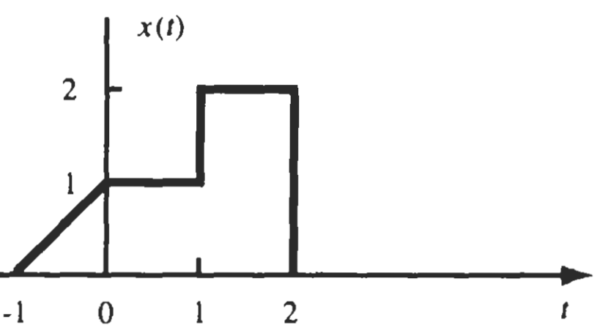

Exp 4.5: A CTS $x\left(t\right)$ is shown in Fig. Sketch and label each of the following signals

Slide 25
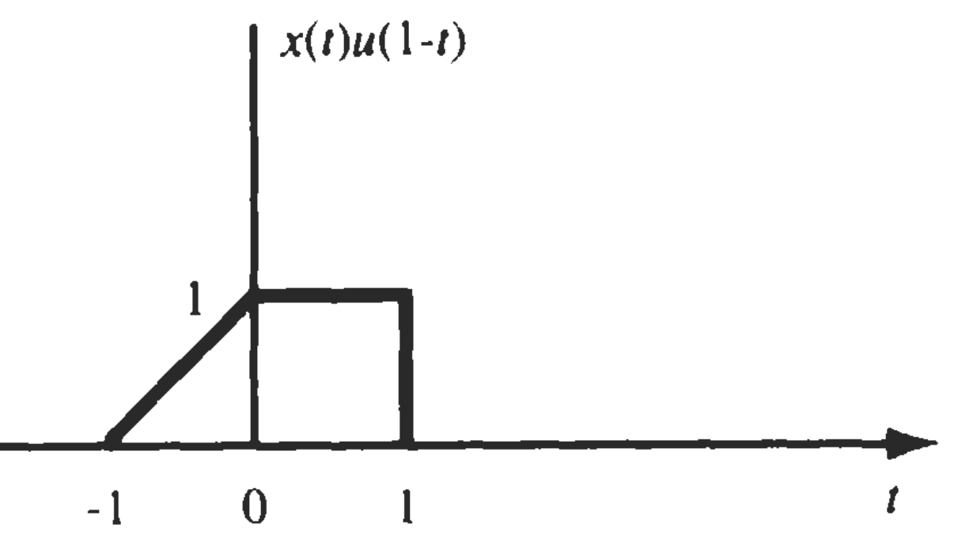
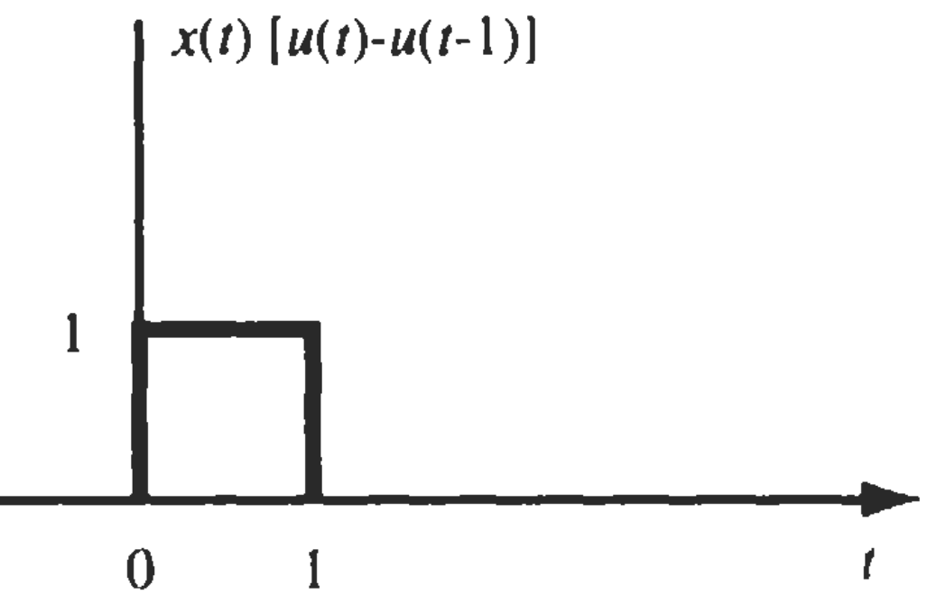
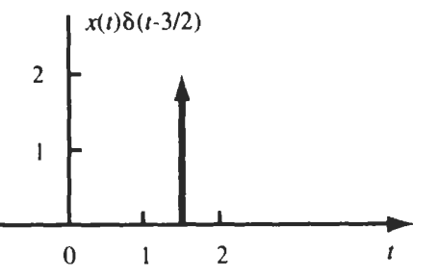

Slide 26
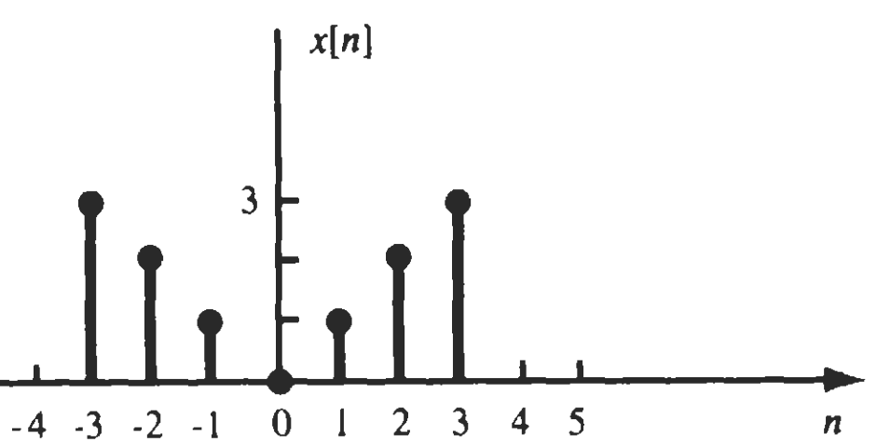
Exp 4.6: A DTS $x$[n] is shown in Fig. Sketch and label each of the following signals

Slide 27
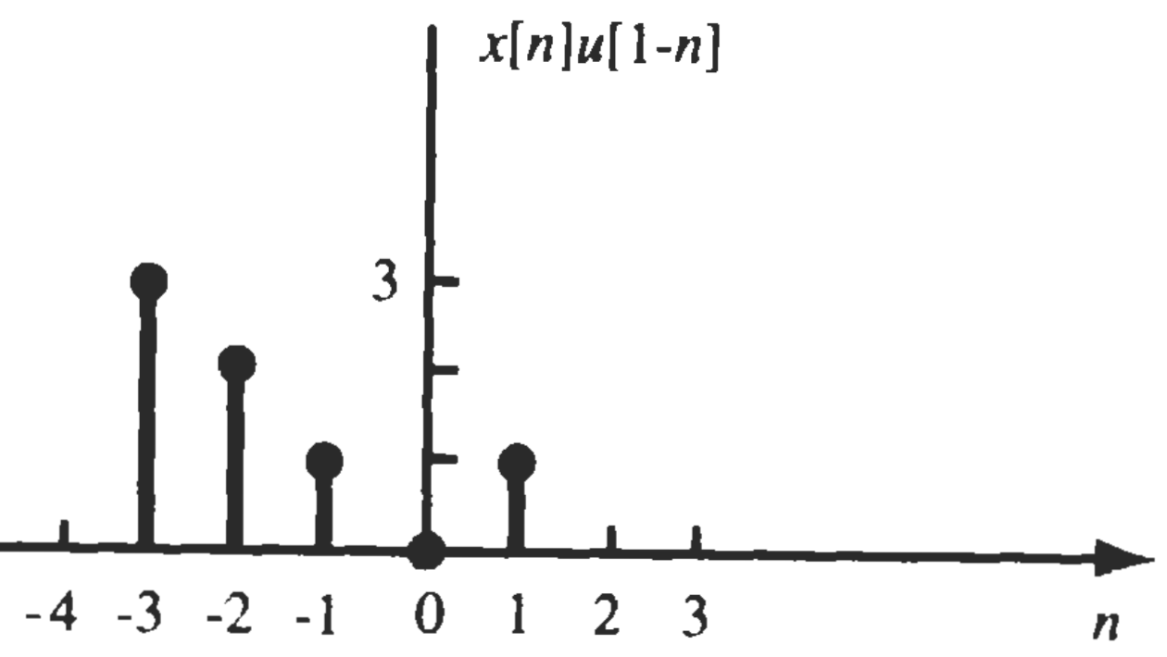
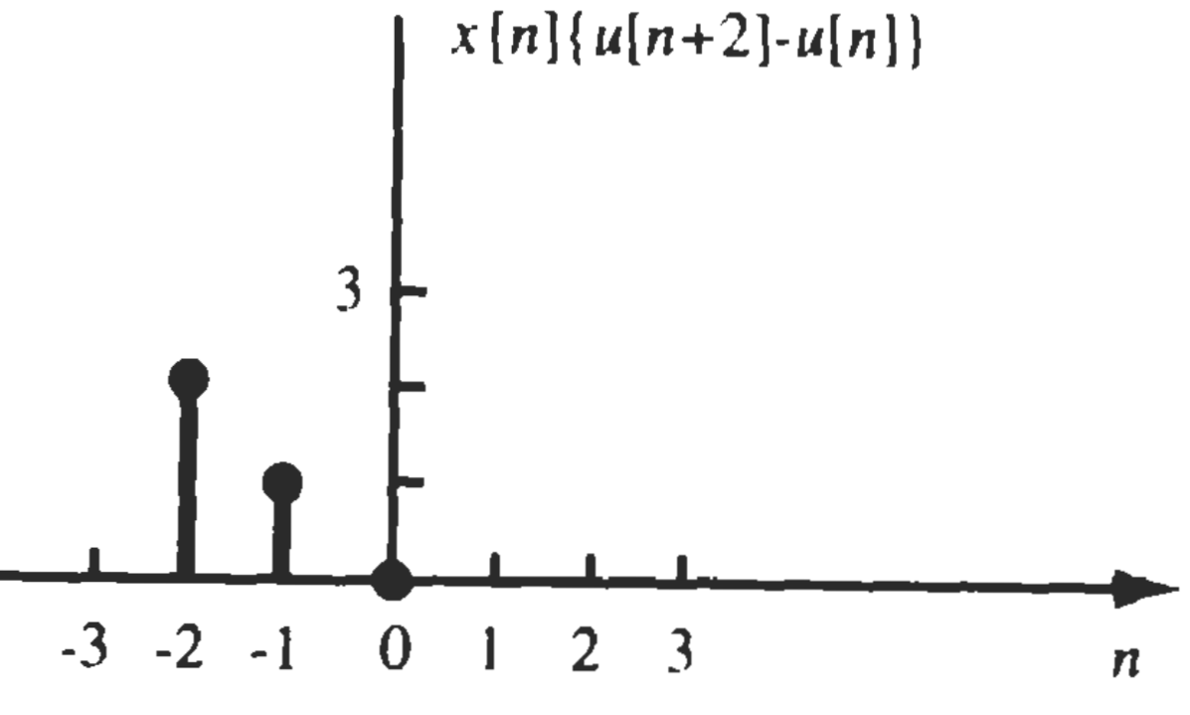
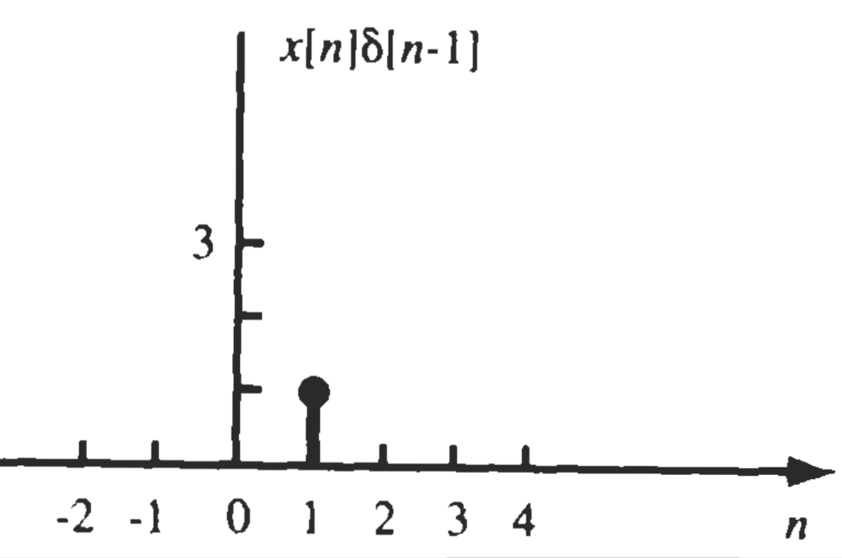

Slide 28


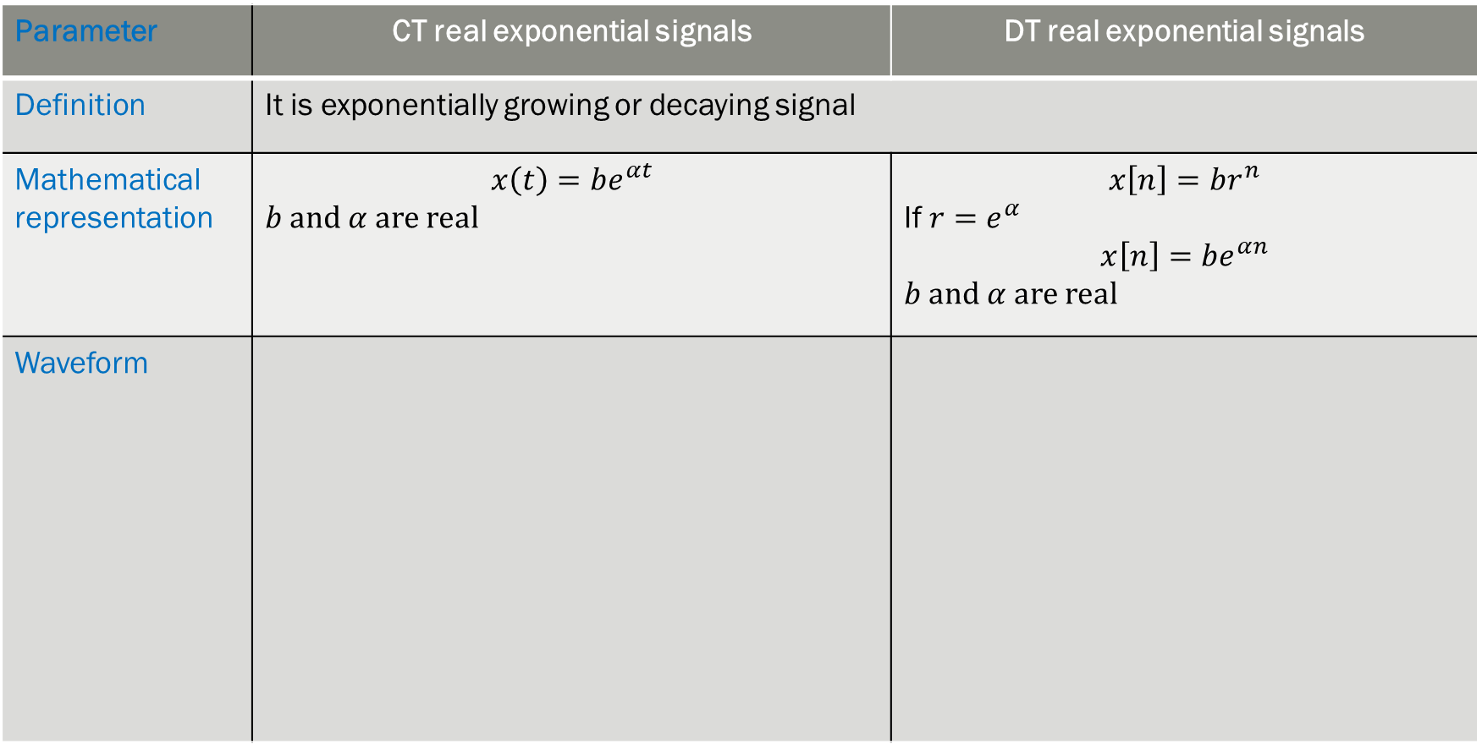


4. Real Exponential Signal
Parameter | CT real exponential signals | DT real exponential signals
Definition | It is exponentially growing or decaying signal
Mathematical representation | $$x\left(t\right)=be^{αt}$$ $b$ and $α$ are real | $$x\left[n\right]=br^{n}$$ If $r=e^{α}$ $$x\left[n\right]=be^{αn}$$ $b$ and $α$ are real
Waveform
$α<0$
Decaying
$$0<r<1$$
Decaying
$α>0$
Rising
$$r>1$$
Rising

Slide 29
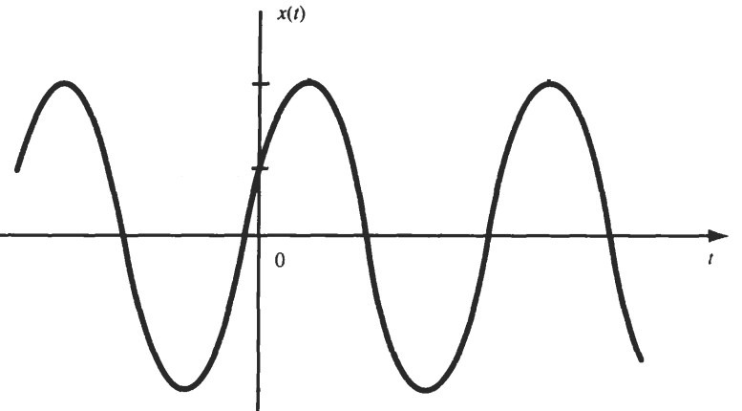
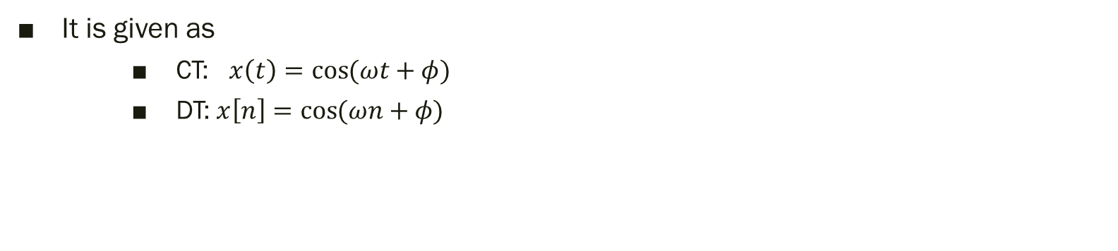
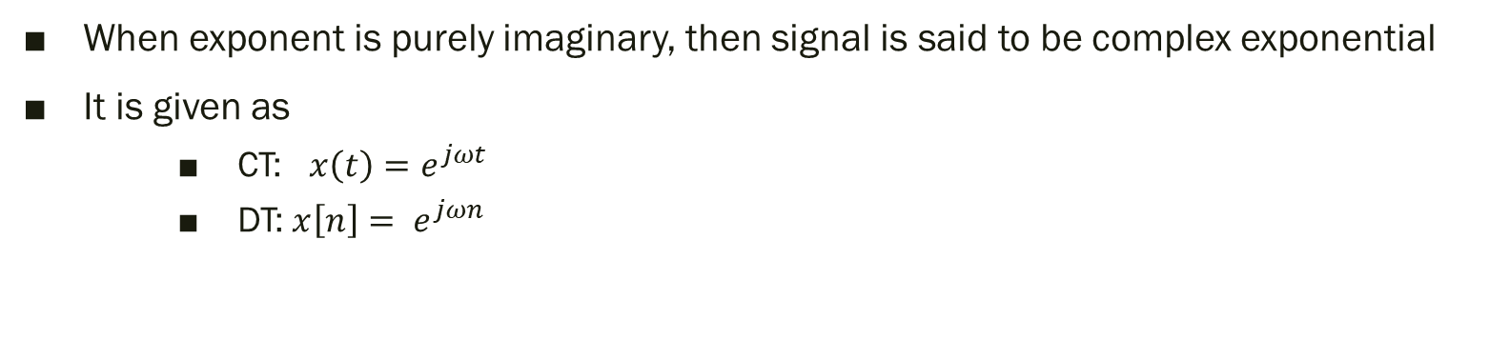
5. Complex Exponential Signal
When exponent is purely imaginary, then signal is said to be complex exponential
It is given as
CT: $x\left(t\right)=e^{jωt}$
DT: $x\left[n\right]= e^{jωn}$
6. Sinusoidal Signal
It is given as
CT: $x\left(t\right)=\cos{(ωt+φ)}$
DT: $x\left[n\right]=\cos{(ωn+φ)}$

Slide 30

P.P 4.2: Evaluate the following integrals (a) $\int_{−1}^{8}{\left[u\left(t+3\right)−2δ\left(t\right)u\left(t\right)\right]dt}$ (b) $\int_{1/2}^{5/2}{δ\left(3t\right)dt}$
Solution:
(a) Ans: 7

Slide 31

P.P 4.3: Draw waveforms of the following (a) $f_{1}\left(t\right)=3u(t−1)$ (b) $f_{2}\left(t\right)=u\left(2−t\right)$ (c) $f\left(t\right)=$ $f_{1}\left(t\right)f_{2}\left(t\right)$

Slide 32
Thank You !!!

